Slide 1

EDFL Under 9s Competition
Rules & Regulations
Produced February 2017

Slide 2
Under 9s Competition
Age Policy
A player must be 7 years of age by April 30 before he/she can participate in competition football in Victoria.
Any Under 9 player is eligible to play up in Under 11s with consent from the individuals parents and Club permission
Players should only be permitted to play up an age level when the physical capacity and social sense enable them to adequately compete in the higher level and the recommendation is that the decision should be based on the benefits gained by the individual.
Gender Policy
In accordance with Equal opportunity Act 1995 (Vic.) people aged under 12 years of Age cannot be excluded on a basis of sex or gender for participating in competitive sporting activity.
The under 9s competition is a mixed program

Slide 3
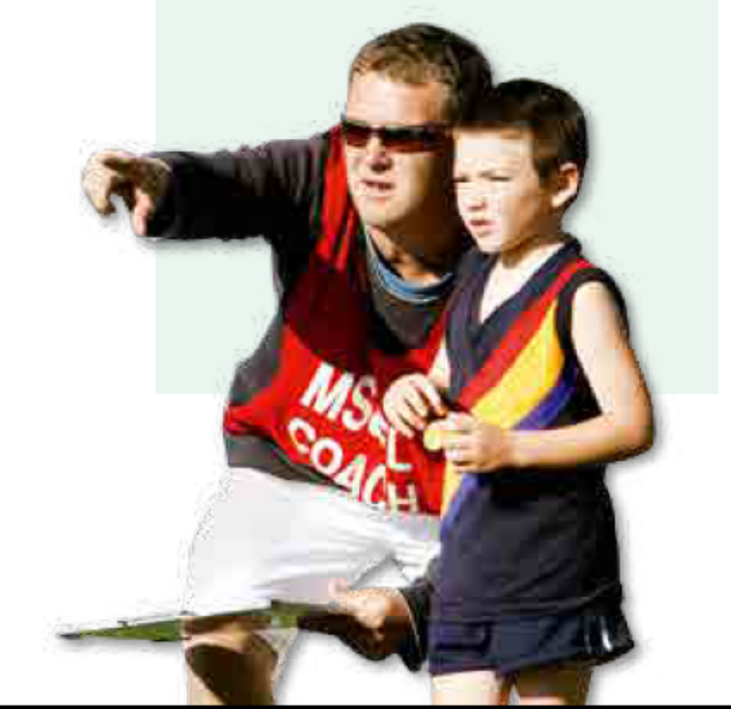
Under 9s Competition
The Team
Twelve-a-side means: 4 forwards, 4 centres, 4 backs + reserves.
Fifteen-a-side means: 5 forwards, 5 midfielders, 5 backs + reserves.
Interchange may take place at any time, but all players must play at least half of the match.
Rotate players every quarter to provide opportunities in several positions, i.e. players to change from one zone to another and interchange on to the field.
Equalise the teams and opponents as much as possible (match sizes, abilities).

Slide 4
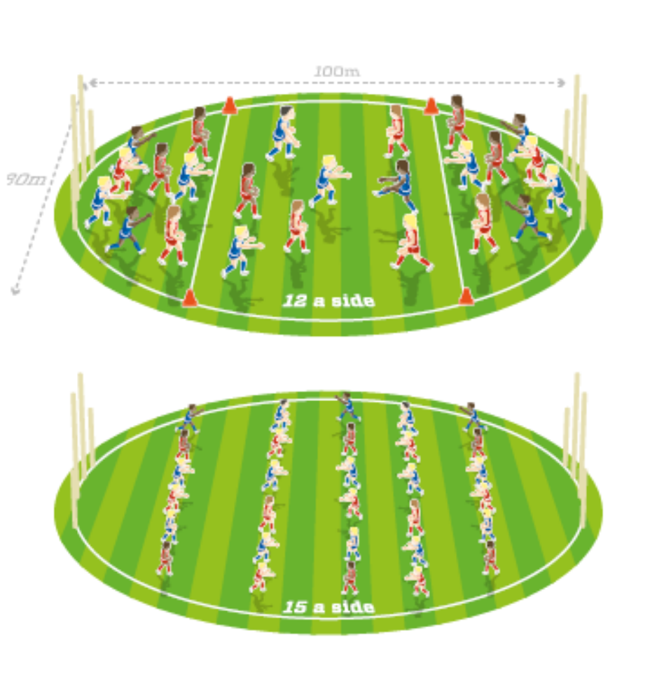
Under 9s Competition
Playing Ground and Officials
The size of the playing field should be no bigger than 100m x 80m and divided into three equal zones (thirds) identified by markers or lines on the ground.
A field umpire is needed.
There are no boundary throw-ins (no boundary umpires)
Two goal umpires are required.
NB: This field is a maximum size with flexibility needed depending on the players per team, age and ability level. Playing on a larger field will compromise the intent of the laws and in turn have an adverse effect on the development of players.

Slide 5
Under 9s Competition
Zones
Backs are restricted to the back zone.
Centres are restricted to the centre zone.
Forwards are restricted to the forward zone.
Players in the centre zone must be identified by a EDFL sash
Rotate players to provide opportunities in several positions
FWD
BACK
CENTRE

Slide 6
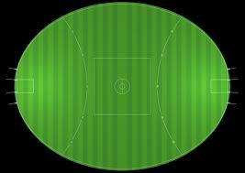
Under 9s Competition
Basic Ground Set Up For 2 Games
Players to wear arm bands in this section
Players to wear arm bands in this section
10 metres

Slide 7
Under 9s Competition
Ground Set Up For 1 Game
Players to wear arm bands in this section

Slide 8
Under 9s Competition
Ground Set Up For 1 Game
Players to wear arm bands in this section

Slide 9
Under 9s Competition
Transition Of Ball
When the ball is in transition from the back zone to the forward zone, it must be touched by a player in the centre zone.
Failure for this to occur will see a free kick awarded to the opposition team at the point at
which the ball entered the end zone.

Slide 10
Under 9s Competition
Scoring
Only players who are positioned as forward zone players may score.
When all players are in position, a ball-up is conducted between two
centre players of similar height as nominated by the umpire. Alternate
players for subsequent bounces.
Start Of Play And Restarting After A Goal

Slide 11
Under 9s Competition
Out Of Bounds
From a kick – a free kick is awarded against the player who last kicked
the ball.
If there is doubt, or if the ball came off hands or body, the umpire
shall call a ball-up 5m in from the boundary. Full possession at the
ball-up is not permitted.

Slide 12
Under 9s Competition
Tackling
Players can perform a modified tackle.
A player in possession of the ball may be tackled by an opponent wrapping both arms around the area below the top of the shoulders and on/above the knees. The tackle may be from either side or from behind providing the tackle from behind does not thrust forward the player with the ball (that is push the player in the back).
If the player in possession of the ball is taken to the ground in the act of tackling, they will receive a free kick.
If the umpire feels the player drops to the ground deliberately in order to receive a free kick, they will be penalised for holding the ball.
A player in possession of the ball, when held by an opponent applying the wrap-around tackle, should be given a reasonable chance to dispose of the ball by kick or by handball, or by attempting to kick or handball, otherwise a free kick shall be awarded to the tackler for holding the ball.
The field umpire shall conduct a ball-up when the player with the ball has the ball held to the body by an opponent, unless the player has had a reasonable time to dispose of the ball before being tackled, in which case a free kick shall be awarded to the tackler for holding the ball.
View the following YouTube clip for greater clarity
https://www.youtube.com/watch?v=y9kWXQaFezA

Slide 13
Under 9s Competition
Contact/Prohibited Contact
The field umpire shall allow play to continue if the ball is knocked accidently out of a player’s hands by an opponent.
A player not in possession of the ball, when held by an opponent, shall be awarded a free kick.
There is strictly no bumping, slinging or deliberately bringing the opposition player in possession of the ball to the ground.
Players cannot:
knock the ball out of an opponent’s hands on purpose;
push the player in the side;
steal the ball from another player;
smother an opponent’s kick;
shepherd an opponent.

Slide 14
Under 9s Competition
The rules have not been modified in any way from the AFL Football Policy and are as follows;
ADMINISTRATION | Modified Rules
Ground Size | 100m x 80m (recommended max.) and divided into 3 equal zones (thirds) NB: this will allow 2 games to be played on the one ground
Zones | ✓
# Players on Ground | 12 to 15 a side
Ball Type | Synthetic Only
Ball Size | 2
Quarter Duration (mins) | 10
Break Length | 3-10-5

Slide 15
Under 9s Competition
UMPIRES | Modified Rules
# Field Umpires | Club – 1* *EDFL Umpire where possible
Boundary Umpires | ✗
Out Of Bounds | From a kick a free kick is awarded against the player who last kicked the ball. From hands, or if there is doubt, then the umpire shall ball it up 10m in from the boundary.
LAWS | Modified Rules
Tackling | Modified (see video)
Bumping | ✗
Stealing The Ball | ✗
Barging | ✗
Smothering | ✗
Fending Off | ✗
Shepherding | ✗
Bouncing The Ball | 1 Max

Slide 16
Under 9s Competition
LAWS | Modified Rules
Kicking Off The Ground | ✗
Ball Ups | Nominated Players of Equal Size
Centre Bounce | Provide equal opportunity for all players to compete, choosing players of equal size
Throw-Ins | ✗
Distance Over Which Marks Are Paid | A mark is awarded, irrespective of the distance the ball has travelled, to any player who catches it or makes reasonable attempt to mark it
Distance Penalty | ✗
Deliberate Out Of Bounds | ✗
Deliberate Rushed Behind | ✗

Slide 17
Under 9s Competition
COMPETITION DETAILS | Modified Rules
Premierships, Ladders / Finals | ✗
Scores Kept | ✗
Record Best Players / Goal Kickers | ✗
League Representative Team Selected | ✗
Coach Allowed On-Field | ✓ We recommend to act as umpire
Runner | ✗
Water Person | ✗

Slide 18
Under 9s Competition
Things To Know
All Players need to be registered and listed on the clubs Team Sheet, which is produced through FootyWeb.
All Coaches need to be accredited and listed on the clubs Team Sheet, which is produced through FootyWeb.
At the end of the match, the Team Manager enters the scores as 0 – 0 and the game will be registered as having been played.
Under 9 matches are played on a Sunday at the scheduled time of 8:30am. Some matches maybe be played at 9:45am if there is no Under 11 game played after.
All Officials still need to wear their EDFL Bibs (Coach, Team Manager, Match Day Official). These can be purchased through Grashan Sportwear.
All EDFL matches operate under the By-Laws and modified rules should be read inline with the AFL Laws of the game. Failure to comply may result in individual sanctions, club sanctions or fines. It is important to ensure that you discuss any applicable compliance matters with your Clubs Junior Coordinator.

